Slide 1






CLIENT SOLUTIONS GROUP (CSG)

Slide 2
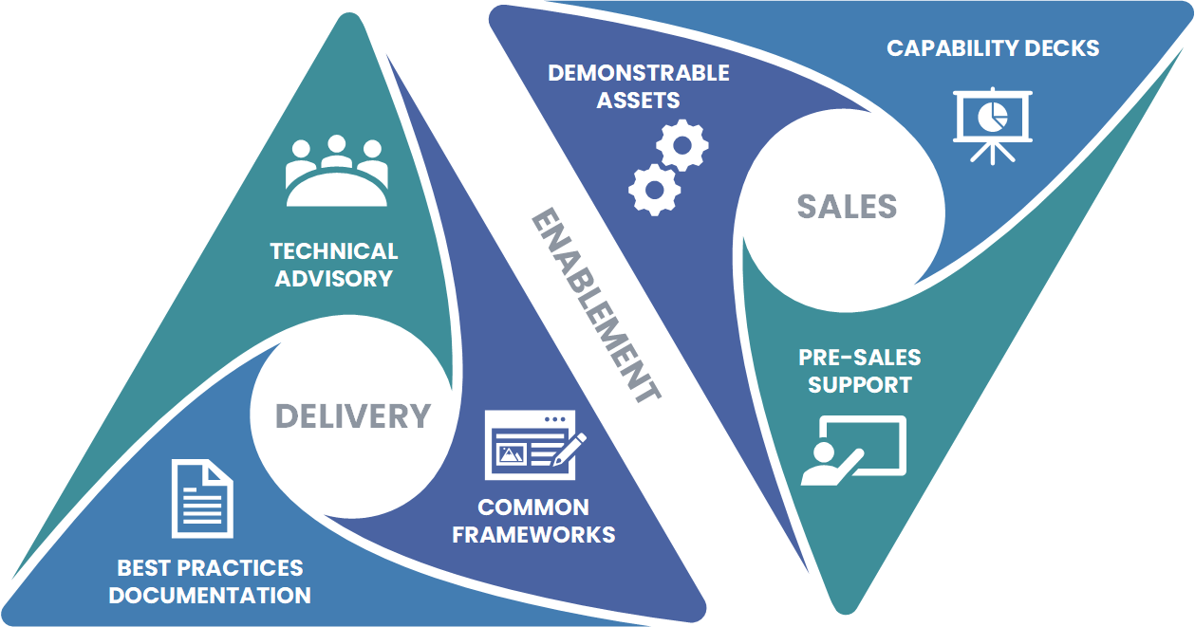
CLIENT SOLUTIONS GROUP VALUE PROPOSITION
ARCHITECT VISIBILITY
Ensure delivery team is positioned to delivery solutions consistently and following best-practices.
Ensure all technical competencies have delivery support. Identify and fill skill-gaps.
Cross-educate Sales and Marketing teams on what Delivery team capabilities and achievements.
Provide technical support for all pre-sales activities.
CONSISTENT & QUALITY DELIVERY
Notes:
Group of senior architects whose goal is to empower delivery and sales/marketing teams

Slide 3



CLIENT SOLUTIONS GROUP ADVISORY
WHY BEING AN ADVISOR MATTERS
STRATEGIC VS. TACTICAL
ENGAGEMENT
SCALABILITY &
FUTURE-PROOFING
Strategic-based engagements tend to be longer-term and more profitable versus those that are more transactional in nature. We are there with them side-by-side learning their business and solving problems.
Understanding industry trends and anticipating future needs with an eye towards short-term wins. Not limiting ourselves to project scope and looking out for client’s best interest.
TRUST
RISK MITIGATION & GOVERNANCE
TECHNICAL DEPTH & THOUGHT LEADERSHIP
Accomplished by providing pro-active unbiased oversight. When issues do arise, providing potential new paths to success.
Knowledge and experience in a wide-range of topics. Emphasis on education and empowerment over individual project implementations.

Slide 4
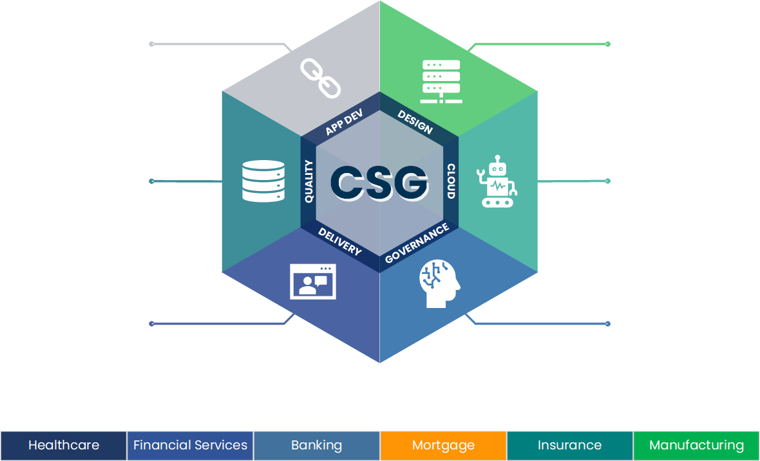
CLIENT SOLUTIONS GROUP TECHNICAL CAPABILITIES
ENTERPRISE INTEGRATIONS
INFRASTRUCTURE
Connectivity between systems, applications, and data sources, ensuring interoperability, scalability, and efficient workflow automation across enterprise environments.
GROWTH
Cloud and on-premises infrastructure expertise, specializing in migrations, well-architected frameworks, and security. Partnered with offshore Infrastructure team.
DATA & ANALYTICS
AUTOMATION
Data and analytics capability, with a market focus on tools like Microsoft Fabric, PowerBI, Tableau and Databricks. Partnered with offshore data delivery team.
GROWTH
Cover workflow optimization (BPA) to AI-driven process automation (Hyper-automation). Specialize in UIPath and Power Platform, Partnered with Canadian UIPath team.
MODERN WORKPLACE
AI/ML
Establishing technology-driven environments that foster collaboration, flexibility, and productivity. Primarily Microsoft focused.
GROWTH
Model development, generative AI, NLP, computer vision, predictive analytics, and AI-driven automation, ensuring scalable and impactful AI adoption. Partnered with offshore AI team.
Group of senior architects whose goal is to empower delivery and sales/marketing teams

Slide 5
CLIENT SOLUTIONS GROUP THE TEAM
SCOTT THOMPSON
POINTS OF CONTACT
Senior Director of Architecture
ENTERPRISE INTEGRATIONS
INFRASTRUCTURE
ONSHORE TEAM
OFFSHORE TEAM
PRIMARY
Scott
BACKUP
TBD
PRIMARY
Scott
BACKUP
Biju, Sugeesh
VENKATA CHEVURU
VENUS VINCENT
DATA & ANALYTICS
AUTOMATION
Solution Architect
Sr Practice Manager
PRIMARY
Scott
BACKUP
Abdul, Anirban
PRIMARY
Venkata (MSFT)
BACKUP
Scott
ANIRBAN GHATAK
PRIMARY
Anmol (UIPath)
CHRIS SHEIKH
Technical Architect
Practice Director
MODERN WORKPLACE
AI/ML
ROJI PHILIP
PRIMARY
Venkata
BACKUP
Scott
PRIMARY
Scott
BACKUP
Roji
ZAHID FAROOQ
Technical Architect
Senior Director
CLOUD
APPLICATION DEVELOPMENT
ABDUL MOHAMMED
SUGESH SUBRAHMANIAN
PRIMARY
Scott
BACKUP Zahid, Venus
PRIMARY
Scott (Azure)
BACKUP
Venus
Technical Architect
Director
PRIMARY
Koti (AWS)

Slide 6

CLIENT SOLUTIONS GROUP WORK IN PROGRESS
Identify and establish CSG practice architects
Organize existing demonstrable assets and identify gaps
Organize and standardize existing technical capability presentations and identify gaps
Organize existing delivery frameworks and standards and identify gaps
Centralize content in Sales Knowledge Base Dashboards
Continuous education with sales (success stories, technical advancements, etc)
TARGET DATE: July/Aug 2025

Slide 7


QUESTIONS AND ANSWERS

Slide 8

THANK YOU
Business focus.
Technology-fueled innovation.
Delivery excellence

